Slide 1
Sampling Distributions

Slide 2
Does treatment work?
Population of rats (weight)
Normal
Inject growth hormone
0.90
2.50
95%
z
-1.96
1.96
µ = 400
σ = 20
Notes:
Previously we learned some mathematical definition of “normality”. Z=0.9 is considered normal because within middle 95% .
Whereas z=2.5 is in the critical region and thus “abnormal’, “extreme”. Which mouse helps to answer the question?

Slide 3
Does treatment work?
Population of rats (weight)
Normal
Inject growth hormone
95%
z
-1.96
1.96
µ = 400
σ = 20
Notes:
Looking at this mouse on its own, the treatment doesn’t seem to work.

Slide 4
Does treatment work?
Population of rats (weight)
Normal
Inject growth hormone
95%
z
-1.96
1.96
µ = 400
σ = 20
Notes:
The second mouse, however, is a rather a rare occurrence among normal mice, but still not improbable. There ARE mice, who without any hormones have this extreme weight. However, at this point we might start to wonder

Slide 5
Does treatment work?
Population of rats (weight)
Normal
Inject growth hormone
mean
95%
z
-1.96
1.96
µ = 400
σ = 20
Notes:
Obviously, by observing both mice we have even better idea of what the treatment does to weight, then any individual mice.

Slide 6
Plan for today: SHIFT
How likely is the score?
How likely is the sample?

Slide 7
Does treatment work?
Population of rats (weight)
Normal
Inject growth hormone
95%
z
-1.96
1.96
µ = 400
σ = 20
Notes:
What would you say if we conduct the experiment on the third mouse? Does it help to answer our question?
Notice that we haven’t seen any mice that would have a weight lower than normal (negative z-score), although there SHOULD be plenty of them. As many as mice ABOVE normal weight. I’m starting to get suspicious…

Slide 8
Does treatment work?
Population of rats (weight)
Normal
Inject growth hormone
95%
z
-1.96
1.96
µ = 400
σ = 20
Notes:
There is definitely something going on! The forth mice had even more extreme weight than any mouse before and we still haven’t seen any mice below normal weight.

Slide 9
Does treatment work?
Population of rats (weight)
Normal
Inject growth hormone
95%
z
-1.96
1.96
µ = 400
σ = 20
Notes:
The fifth mouse has a below average weight, but still we see how the higher weights occur more frequently than we expect from the normal curve.
If treatment has NO EFFECT, where should they cluster around? – 400
Instead they cluster around some higher value.
The sample of 5 TREATED mice represents the POPULATION OF treated mice, which we know is distributed normally and has a SD=20 (same as the untreated, one of the assumptions).

Slide 10
Population of UNTREATED mice
µ = 400
σ = 20
25
Population of TREATED mice
µ = 425
σ = 20
Notes:
If we have access to both populations, what would you conclude? Does treatment have effect?
You should. If we knew the pop.mean for sure.
You should conclude that “the treatment increases the adult weight by 25 gramms”
This is what it takes to make such conclusion : comparison of two populations

Slide 11
Population of UNTREATED mice
Population of TREATED mice
µ = 400
σ = 20
?
M = 419
Sampling Error
419
µ = ?
σ = 20
Notes:
But we don’t know the population mean of TREATED mice.
How can we find out? How can we ESTIMATE it? Sample the population of TREATED mice!
According to this sample, the population’s mean is 419. It this right? How can we verify? Take another sample!
Sample error : discrepancey or amont of error b/w sample st. and corresponding pop. parameter.
Looking ahead: How well does this sample mean estimate the population mean? Any way to know specifically the probability? What is the probability that this sample mean would lie within 1 SD from the population mean, 2 SD? Within the middle 95%? You see where I am going with this

Slide 12
Population of UNTREATED mice
Population of TREATED mice
µ = 400
σ = 20
?
M = 422
419
422
µ = ?
σ = 20
Notes:
Another sample gives us a different value. It’s not exactly the same as the previous sample, but it’s closer to the TREATED sample value than to the UNTREATED mean. Let’s take another one

Slide 13
Population of UNTREATED mice
Population of TREATED mice
µ = 400
σ = 20
?
M = 431
419
422
431
Sampling Variability
µ = ?
σ = 20
Notes:
Three times in a row we get extreme values. Three times in a row we get VARIOUS, DIFFERNET values
Samples vary. Even thought we observe the same population (TREATED MICE) each time we observe a slightly different part of it. Different samples would have different means, this is NATURAL VARIABILITY or SAMPLING VARIABILITY.
If we keep sampling and obtain many sample means, we can put them into a DISTRIBUTION
DEFINITION: The tendency for the statistics to vary from sample to sample.

Slide 14
Population of UNTREATED mice
Population of TREATED mice
µ = 400
σ = 20
?
424
421
429
410
419
426
405
411
418
427
440
Distribution of Sample Means
µ = ?
σ = 20
Notes:
Or more generally, SAMPLING DISTRIBUTION ( of some statistic)
DEFINITION : collection of means of all possible random samples (of a given size n) obtained from the population
DEFINITION: Sampling distribution: distribution of some statistics obtained from all possible random samples (of a given size n) from a population.
These distributions are HYPOTHETICAL! We can take ALL possible samples from the population in reality.
However, we can take a simplified case and study the properties of the SAMPLING DISTRIBUTIONS.

Slide 15
Distribution of Samples Means
Piles up around µ
Appears normal in shape
424
421
429
410
419
426
405
411
418
427
440
µ
Distribution of Sample Means
Notes:
Lets list some properties that we are beginning to suspect the DSM has.
Let’s see if we can verify these properties

Slide 16
Empirical Sampling Distribution
Sample # (n =2) | X1 | X2 | Mean
1 | 2 | 2 | 2
2 | 2 | 4 | 3
3 | 2 | 6 | 4
4 | 2 | 8 | 5
5 | 4 | 2 | 3
6 | 4 | 4 | 4
7 | 4 | 6 | 5
8 | 4 | 8 | 6
9 | 6 | 2 | 4
10 | 6 | 4 | 5
11 | 6 | 6 | 6
12 | 6 | 8 | 7
13 | 8 | 2 | 5
14 | 8 | 4 | 6
15 | 8 | 6 | 7
16 | 8 | 8 | 8
1
2
3
4
5
6
7
8
9
µ = 5
Population
6
1
2
3
4
5
6
7
8
9
µ = 5
Sampling Distribution
Notes:
Random sampling requires sampling with replacement!

Slide 17
Distribution of Samples Means
Piles up around µ
Normal in shape
The larger the sample size, the closer to µ
424
421
429
410
419
426
405
411
418
427
440
µ
Distribution of Sample Means
Notes:
This is intuitive, but let’s check this intuition and make sense of it.

Slide 18
Does treatment work? Sample 1
Population of rats (weight)
Normal
Inject growth hormone
95%
z
-1.96
1.96
µ = 400
σ = 20
Notes:
What is a better evidence that the treatment works?

Slide 19
Does treatment work? Sample 2
Population of rats (weight)
Normal
Inject growth hormone
95%
z
-1.96
1.96
µ = 400
σ = 20
Notes:
What is a better evidence that the treatment works?
The mean of which is a better approximation of the TREATED population mean?
What is the error between the sample mean and population mean we can expect on average in both samples? Which one is bigger?

Slide 20
The law of large numbers
The larger the sample size (n) the more probable that the sample mean (M) would be similar to the population mean (µ )
Notes:
This law refers to the size of ONE sample. The larger the sample, the better our guess of what the population mean is ( our sample mean)

Slide 21
Each sample mean is an element in hypothetical Sampling Distribution
Mean of Sampling distribution piles around the mean of the population
Looks normal
What is the standard deviation?
Population of TREATED mice
424
Sample
421
429
410
419
426
405
411
418
427
440
427
µ
Notes:
If we know the SD of this distribution we would be able to make probabilistic statements about the likelihood of observing a particular sample mean.
In other words, “Is 427 a normal score for this distribution? Does it fall into the “middle 95 %”?
How would we answer that question?

Slide 22
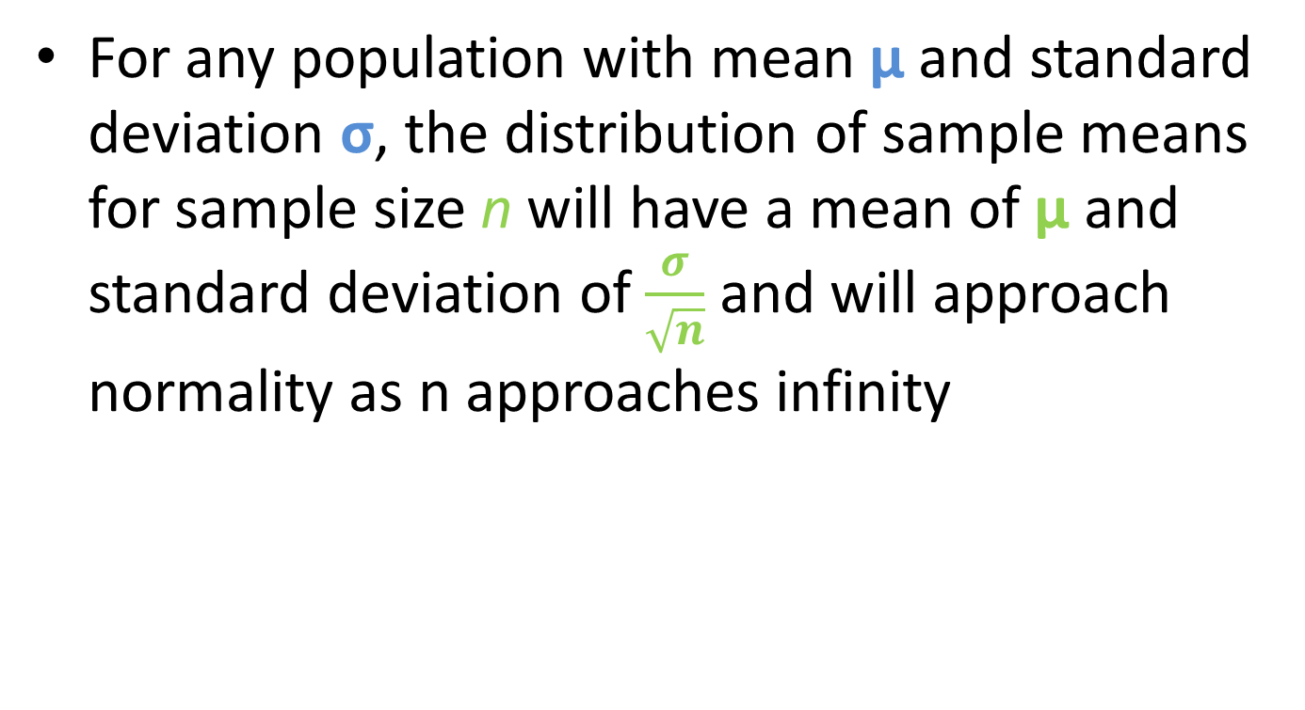
Central Limit Theory
For any population with mean µ and standard deviation σ, the distribution of sample means for sample size n will have a mean of µ and standard deviation of $\frac{σ}{\sqrt{n}}$ and will approach normality as n approaches infinity

Slide 23
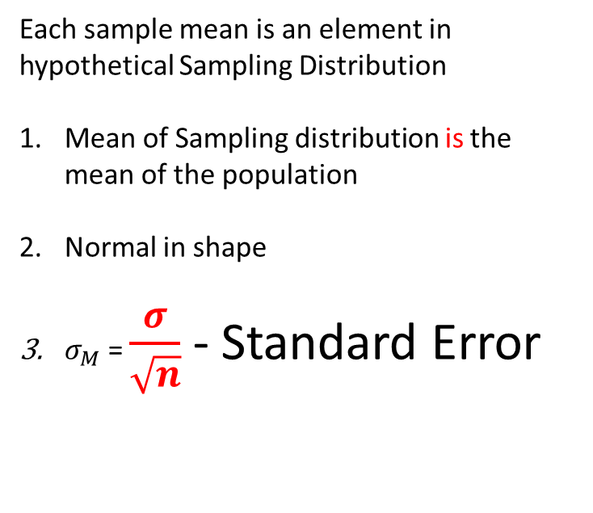
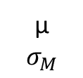
Central Limit Theory
Each sample mean is an element in hypothetical Sampling Distribution
Mean of Sampling distribution is the mean of the population
Normal in shape
$σ_{M}$ = $\frac{σ}{\sqrt{n}}$ - Standard Error
Population of TREATED mice
424
Sample
421
429
410
419
426
405
411
418
427
440
427
µ
$$σ_{M}$$
Notes:
If we know the SD of this distribution we would be able to make probabilistic statements about the likelihood of observing a particular sample mean.
In other words, “Is 427 a normal score for this distribution? Does it fall into the “middle 95 %”?
How would we answer that question?

Slide 24

$σ_{M}$ = $\frac{σ}{\sqrt{n}}$ - Standard Error
SD in (hypothetical) distribution of sample means
Average sampling error
Expected difference between M and µ
Tells us how well the sample mean estimates the population mean.

Slide 25
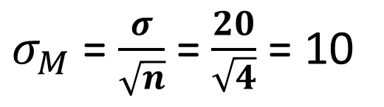
Sample 1: What is standard error?
Population of rats (weight)
Normal
Inject growth hormone
95%
z
-1.96
1.96
µ = 400
σ = 20
$σ_{M}$ = $\frac{σ}{\sqrt{n}}$ = $\frac{20}{\sqrt{4}}$ = 10
Notes:
Based on the value of standard error, the mean of what sample

Slide 26
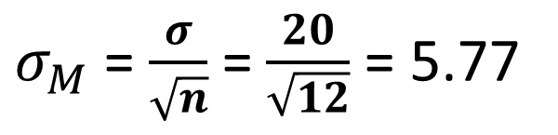
Sample 1: What is standard error?
Population of rats (weight)
Normal
Inject growth hormone
95%
z
-1.96
1.96
µ = 400
σ = 20
$σ_{M}$ = $\frac{σ}{\sqrt{n}}$ = $\frac{20}{\sqrt{12}}$ = 5.77
Notes:
Based on the value of standard error, the mean of what sample

Slide 27
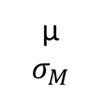
Consequences of CLT
Check
Population from which samples are taken is normal
NORMAL
Sample size is greater than 30
424
421
429
410
419
426
405
411
418
427
440
µ
$$σ_{M}$$
Notes:
Even if the population from which the sample is taken is NOT NORMAL, if the sample size is larger than 30, the distribution of SAMPLE MEANS will be normal.

Slide 28
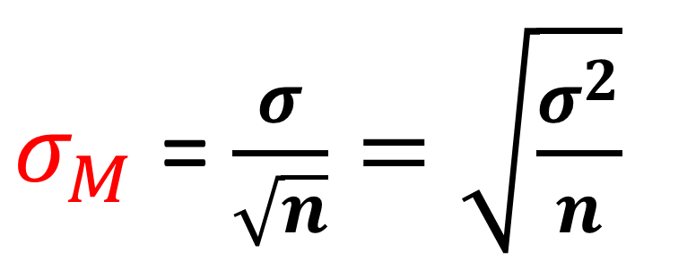
Standard Error and Sample size
How much every element in population is expected to differ from µ
$σ_{M}$ = $\frac{σ}{\sqrt{n}}=\sqrt{\frac{σ^{2}}{n}}$
Divide the responsibility for error among many observations
Notes:
(sigma) = How much EVERY element in population is expected to differ from (mu)
Error – responsibility for accuracy. When (n=1) one element (mouse) is fully responsible to provide accurate measure of sample mean. But it won’t do it perfectly, on avarage it will deviate from (mu) by (sigma).
Let’s devide responsibility to provide the accurate measure! The more (n) the less responsibility falls on shoulders of a particular individual!

Slide 29
What can we do with all of this?
Law of large numbers
Central Limit Theorem
Consequences of CLM
Properties of Normal Distribution
How “normal” the sample mean is
Is it within the middle 95%?
Notes:
Do:
Example 7.2
Example 7.3

